Slide 1

Guardian of the Galaxy

Slide 2
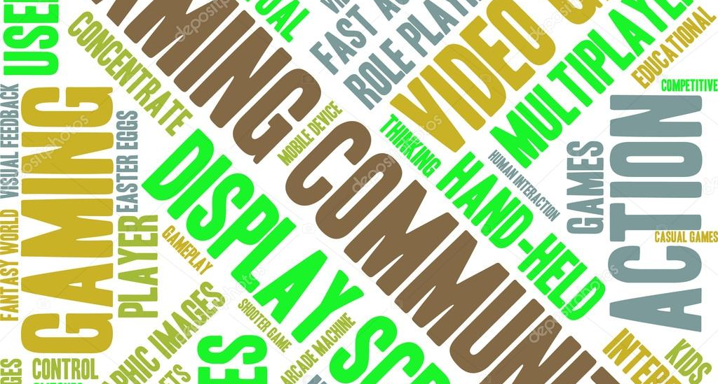
INTRODUCTION
Computer Graphics in Gaming Industry
“Computer Graphics deals with creation, manipulation and storage of different type of images and objects.”
Computer Graphics is used where a set of image needs to be manipulated or the creation of the image in the form of pixels and is drawn on the computer.
Computer Graphics has several Applications like, Computer Art, Presentation Graphics, Visualization etc. It is a vast subject and area in the field of computer science.
Computer graphics plays an important role in gaming world.

Slide 3
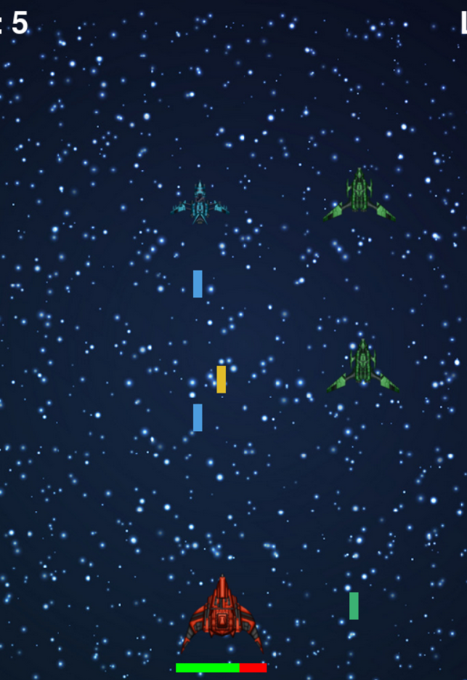
ABOUT THE GAME
Guardian of the Galaxy
The Guardian of the Galaxy is a 2D single player game.
The Guardian of the Galaxy is based upon 1978’s famous arcade game Space Invaders developed by Taito Corporation.
The game is developed using python.
The game is simple to understand but challenging to play, you will be controlling a spaceship, you are going to face a lot enemy ships, their main motive is to destroy your ship. You have to be careful and extra dodgy, your laser weapon is powerful, it can take out the enemy ship in a single fire. You have powerful defense but it can only save you for some time so remember you are not immune to enemy fire.

Slide 4
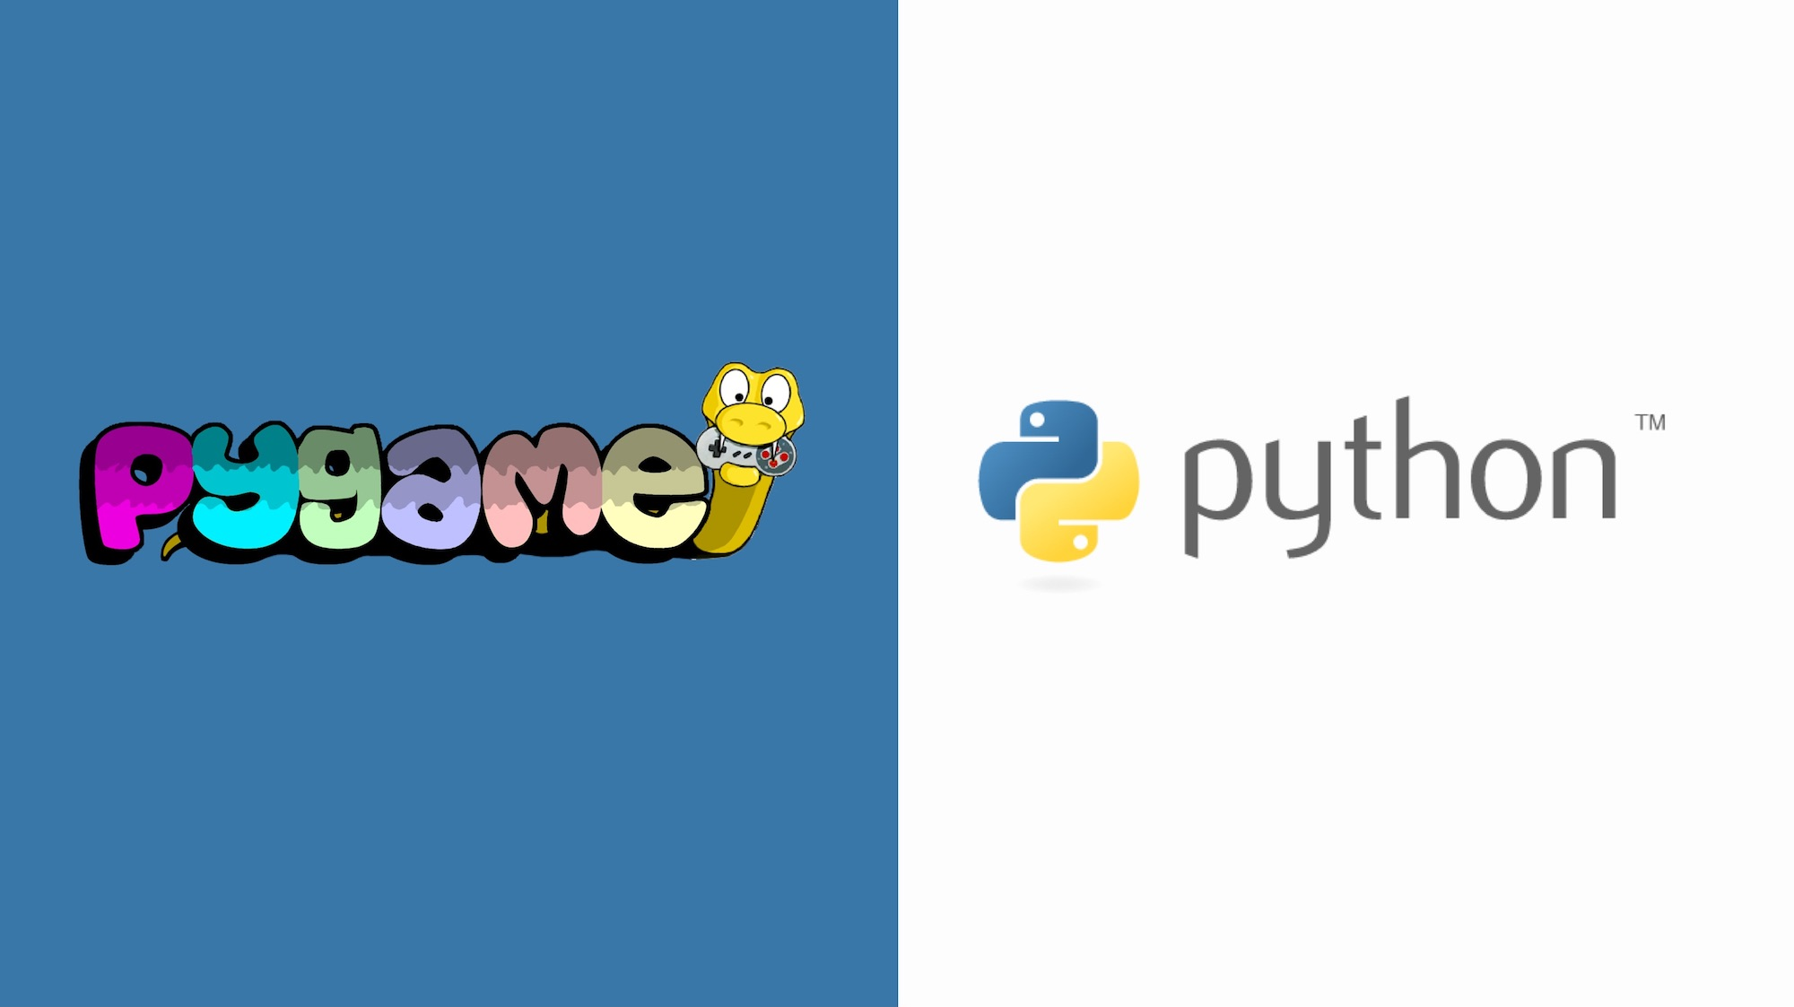
Language/Tools
Language Used:
PYTHON 3.9.0
Modules Used:
Pygame
OS
Time
Random
IDE Used:
PyCharm
Visual Studio Code

Slide 5
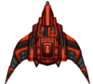






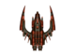
Game Assets
Pictures and sprites of our game.
Defender (Our Ship)
Green (Enemy Ship)
Blue (Enemy Ship)
Red (Enemy Ship)
Background
Yellow Laser
Green Laser
Blue Laser
Red Laser

Slide 6
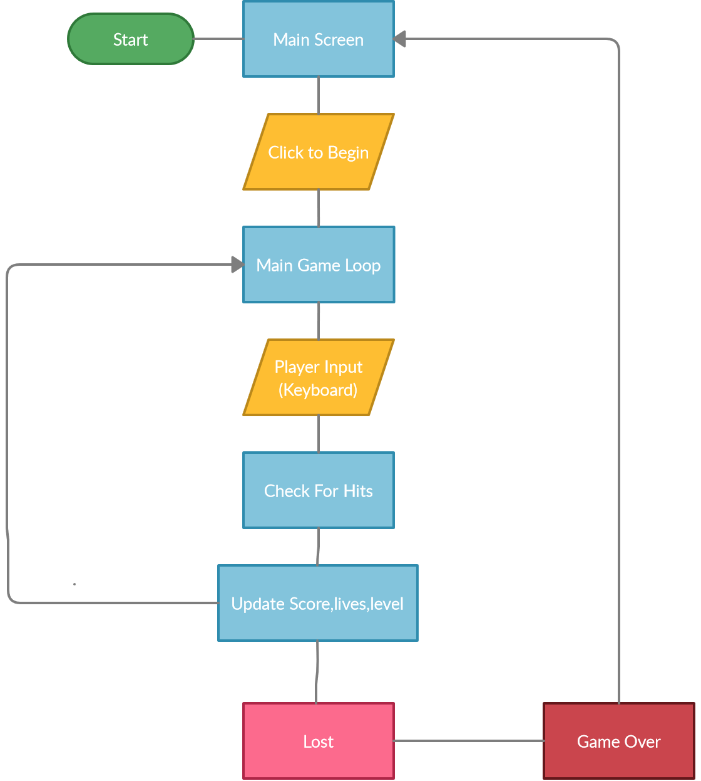
Flow Chart

Slide 7
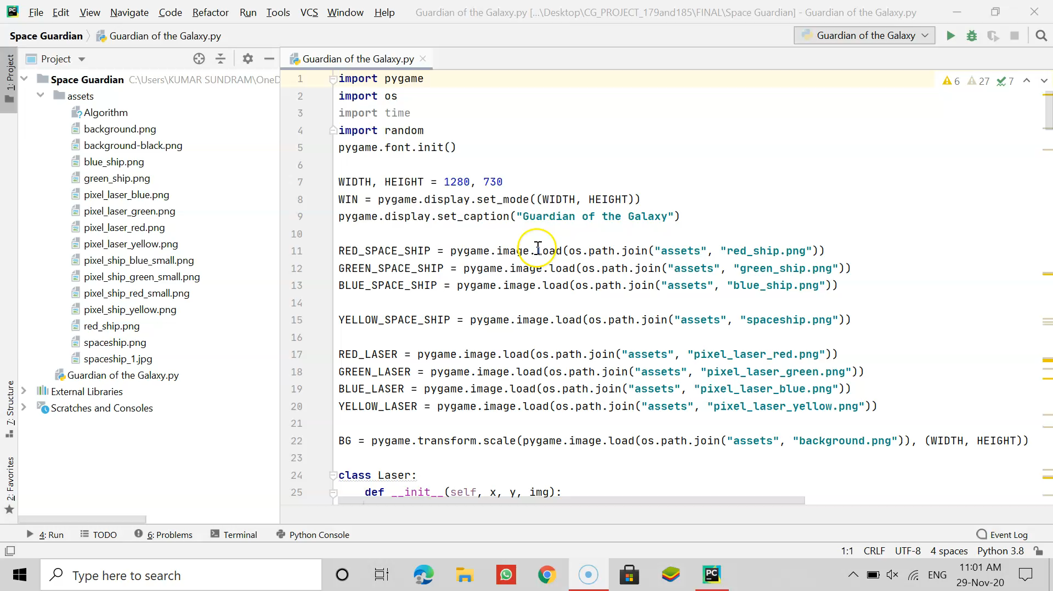

Slide 8
FUTURE SCOPE and IMPROVS
The game can be further improved for multi-players.
It can be modified to give a better user interface.
More levels can be added in the game.
A menu can also be added for providing different difficulty levels (Easy, Medium, Hard).
More spaceships can also be added to provide a better gaming experience.

Slide 9
REFRENCES
https://www.pygame.org/
https://www.geeksforgeeks.org/introduction-to-computer-graphics/
https://pythonprogramming.net/pygame-python-3-part-1-intro/
https://www.javatpoint.com/pygame
https://www.researchgate.net/publication/343319593_THE_DESIGN_AND_IMPLEMENTATION_OF_THE_2D_ARCADE_GAME_DUAL_SPACE_INVADERS

Slide 10
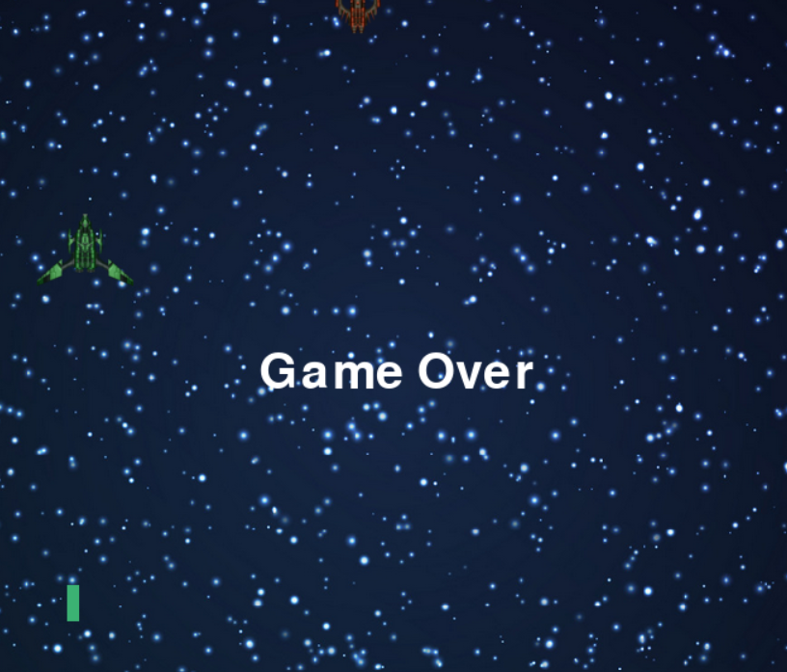
THANK YOU!

